Slide 1
Secure data hiding in images using steganography
CAPSTONE PROJECT
Presented By: Vijay
Student Name : TELUGU VIJAY
College Name & Department : Dr MGR EDUCATIONAL AND
RESEARCH INSTITUTE & BTECH CSE-AI

Slide 2
OUTLINE
Problem Statement
Technology used
Wow factor
End users
Result
Conclusion
Git-hub Link
Future scope

Slide 3
Problem Statement
Organizations face increasing cybersecurity threats, including data breaches and unauthorized access, risking
sensitive information and operational disruption. Current security measures are insufficient against evolving
cyber-attacks. This project aims to develop a robust cybersecurity solution to enhance data protection, prevent
unauthorized access, and ensure system integrity and confidentiality.The challenge is to create a web-based
application that uses advanced encryption and steganography to securely encrypt and decrypt messages within
images, ensuring only authorized access.

Slide 4
Technology used
Programming Language: Python
Libraries: OpenCV (for image processing), NumPy (for numerical operations), OS (for file handling)
Platform: Windows OS for development and testing
Tools: IDLE or any Python IDE for coding and debugging
Encryption Technique: Steganography for secure data hiding
Platforms:
python IDLE
GITHUB

Slide 5
Wow factors
Advanced Steganography: Utilizes pixel-level encoding for enhanced data security, making the hidden message nearly undetectable.
Advanced Encryption and Decryption:The project uses state-of--the-art encryption algorithms to securely hide and retrieve messages within images,ensuring maximum data protection.
Password Protection:Incorrect passwords generate random characters and symbols,adding an extra layer of security by safeguarding against unauthorized access.
Dual Security Layer: Combines steganography with password protection for double-layered encryption.
Lightweight and Efficient: Minimal impact on image quality and size, maintaining high resolution after encryption.
Cross-Platform Compatibility: Works seamlessly on various operating systems, enhancing usability.
User-Friendly Interface: Simple input prompts for encryption and decryption, ensuring ease of use for non-technical users.
Education Value:As part of the IBM Cyber Security Internships,this project not only provides practical solutions but also serves as an educational tool for learning about cybersecurity and steganography.

Slide 6
End users
Military Personnel: This includes soldiers, commanders, and defense strategists who rely on secure communication systems, data encryption, and protection against cyber espionage.
Industrial Employees: Engineers, managers, and operators who need secure access to industrial control systems (ICS) and protection against cyber threats like ransomware.
Media and Journalism:Journalists needing to protect sensitive information.
IT Administrators: Responsible for maintaining and monitoring cybersecurity systems, ensuring data integrity, and responding to cyber incidents.
Healthcare:Healthcare professionals safeguarding patient records.
Government and Law Enforcement:Government officials handling classified information.
Top Management: Decision-makers who require secure channels for confidential communication and strategic planning.
Third-party Contractors: External vendors or consultants who need secure but limited access to specific systems or networks.
These end users require high-level security measures to protect sensitive data, maintain operational continuity, and defend against cyber threats specific to military and industrial environments

Slide 7
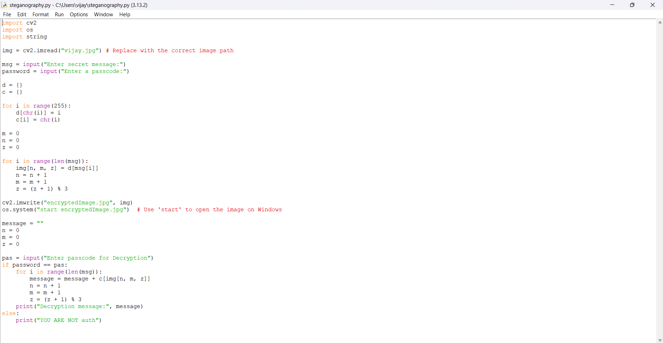
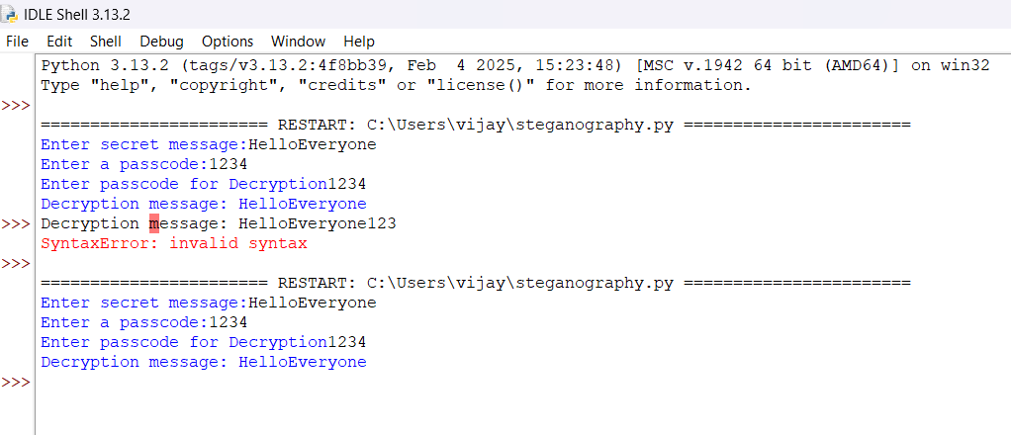
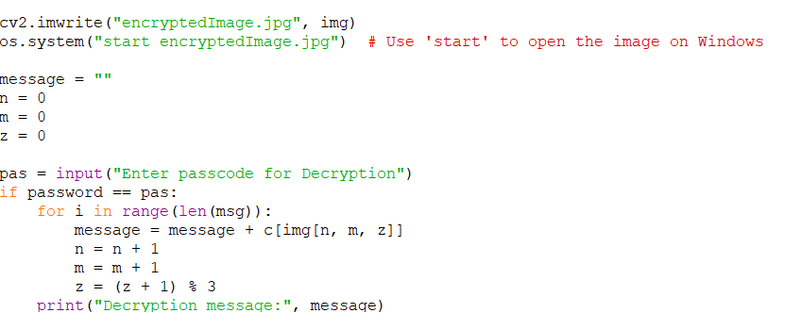
Results
output
code
Encryption and Decryption

Slide 8
Conclusion
In conclusion, the IBM-Intern-Secure-Data-Hiding-in-Image-Using-Steganography project successfully addresses the critical need for secure data transmission in ourincreasingly digital world.
By leveraging advanced technologies such as HTML, CSS (Tailwind CSS), TypeScript, React, Vite, Python (Flask), and Pillow, this web application provides a robust solution for encrypting and decrypting messages hidden within images.
The implementation of steganography ensures that sensitive information remains confidential and protected from unauthorized access.
This project not only demonstrates the potential of combining modem web development frameworks with cybersecurity principles but also sets the stage for future enhancements, including multilanguage support, advanced encryption algorithms, and mobile application development.
Through this initiative, we have taken a significant step towards safeguarding digital communication and ensuring privacy in the digjital age.

Slide 9
GitHub Link
Make sure that there should be readme file.
https://github.com/vijay44-mca/IBM-Intern-Secure-Data-Hiding-Img.git

Slide 10
Future scope(optional)
Better Threat Detection: Using smarter tools to find and stop cyber-attacks more accurately.
Handling More Users and Devices: Making the system strong enough to protect more people and devices as they are added.
Working with New Technologies: Updating the system to work well with new tech like quantum computers and blockchain.
Sharing Threat Information: Connecting with other cybersecurity groups worldwide to learn about new threats faster.
Training Users: Creating better training programs to help people avoid cyber-attacks like phishing.
Following Rules and Standards: Making sure the system follows all the latest security laws and guidelines, especially for the army and industries.

Slide 11
THANK YOU

